Slide 1
Deques

Slide 2
Outline
This topic discusses the concept of a queue:
Description of an Abstract Deque
Applications
Implementations
The STL and Iterations

Slide 3
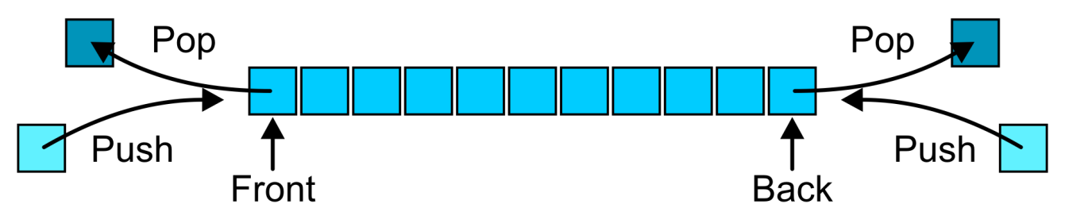
Abstract Deque
3.4.1
An Abstract Deque (Deque ADT) is an abstract data structure which emphasizes specific operations:
Uses a explicit linear ordering
Insertions and removals are performed individually
Allows insertions at both the front and back of the deque

Slide 4
Abstract Deque
3.4.1
The operations will be called
front back
push_front push_back
pop_front pop_back
There are four errors associated with this abstract data type:
It is an undefined operation to access or pop from an empty deque

Slide 5
Applications
3.4.2
Useful as a general-purpose tool:
Can be used as either a queue or a stack
Problem solving:
Consider solving a maze by adding or removing a constructed path at the front
Once the solution is found, iterate from the back for the solution

Slide 6
Implementations
3.4.3
The implementations are clear:
We must use either a doubly linked list or a circular array
Notes:
6

Slide 7
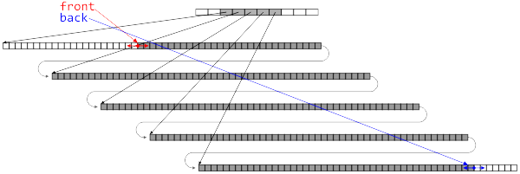
Standard Template Library
3.4.4
The C++ Standard Template Library (STL) has an implementation of the deque data structure
The STL stack and queue are wrappers around this structure
The implementation is not specified, but the constraints are given which must be satisfied by any implementation
Notes:
7

Slide 8
Standard Template Library
3.4.4
The STL comes with a deque data structure:
deque<T>
The signatures use stack terminology:
T &front();
void push_front(T const &);
void pop_front();
T &back();
void push_back(T const &);
void pop_back();

Slide 9
Standard Template Library
3.4.4
{eceunix:1} g++ deque_example.cpp
{eceunix:2} ./a.out
Is the deque empty? 0
Size of deque: 4
Back of the deque: 6
Back of the deque: 4
Back of the deque: 5
Back of the deque: 3
Is the deque empty? 1
{eceunix:3}
#include <iostream>
#include <deque>
using namespace std;
int main() {
deque<int> ideque;
ideque.push_front( 5 );
ideque.push_back( 4 );
ideque.push_front( 3 );
ideque.push_back( 6 ); // 3 5 4 6
cout << "Is the deque empty? " << ideque.empty() << endl;
cout << "Size of deque: " << ideque.size() << endl;
for ( int i = 0; i < 4; ++i ) {
cout << "Back of the deque: " << ideque.back() << endl;
ideque.pop_back();
}
cout << "Is the deque empty? " << ideque.empty() << endl;
return 0;
}

Slide 10
Accessing the Entries of a Deque
3.4.5
We will see three mechanisms for accessing entries in the deque:
Two random access member functions
An overloaded indexing operator ideque[10]
The at() member function; and ideque.at( 10 );
The iterator design pattern
The difference between indexing and using the function at( int ) is that the second will throw an out_of_range exception if it accesses an entry outside the range of the deque

Slide 11
T &deque::operator[]( int ) T &deque::at( int )
3.4.5
#include <iostream>
#include <deque>
using namespace std;
int main() {
deque<int> ideque;
ideque.push_front( 5 ); ideque.push_back( 4 );
ideque.push_front( 3 ); ideque.push_back( 6 ); // 5 3 4 6
for ( int i = 0; i <= ideque.size(); ++i ) {
cout << ideque[i] << " " << ideque.at( i ) << " ";
}
cout << endl;
return 0;
}
{eceunix:1} ./a.out # output
5 5 3 3 4 4 6 6 0
terminate called after throwing an instance of 'std::out_of_range'
what(): deque::_M_range_check
Abort

Slide 12
Stepping Through Deques
3.4.5
From Project 1, you should be familiar with this technique of stepping through a Single_list:
Single_list<int> list;
for ( int i = 0; i < 10; ++i ) { list.push_front( i ); }
for ( Single_node<int> *ptr = list.head(); ptr != 0; ptr = ptr->next() ) {
cout << ptr->retrieve();
}
Notes:
12

Slide 13
Stepping Through Deques
3.4.5
There are serious problems with this approach:
It exposes the underlying structure
It is impossible to change the implementation once users have access to the structure
The implementation will change from class to class
Single_list requires Single_node
Double_list requires Double_node
An array-based data structure does not have a direct analogy to the concept of either head() or next()
Notes:
13

Slide 14
Stepping Through Deques
3.4.5
More critically, what happens with the following code?
Single_list<int> list;
for ( int i = 0; i < 10; ++i ) { list.push_front( i ); }
Single_node<int> *ptr = list.head();
list.pop_front();
cout << ptr->retrieve() << endl; // ??
Notes:
14

Slide 15
Stepping Through Deques
3.4.5
Or how about…
Single_list<int> list;
for ( int i = 0; i < 10; ++i ) { list.push_front( i ); }
delete list.head(); // ?!
Notes:
15

Slide 16
Iterators
3.4.5
Project 1 exposes the underlying data structure for evaluation purposes
This is, however, not good programming practice
The C++ STL uses the concept of an iterator to solve this problem
The iterator is not unique to C++
It is an industry recognized approach to solving a particular problem
Such a solution is called a design pattern
Formalized in Gamma et al. work Design Patterns
Notes:
16

Slide 17
Standard Template Library
3.4.5
Associated with each STL container class is an nested class termed an iterator:
deque<int> ideque;
deque<int>::iterator itr;
The iterator “refers” to one position within the deque
It is similar a pointer but is independent of implementation

Slide 18
Analogy
3.4.5
Consider a filing system with an administrative assistant
Your concern is not how reports are filed (so long as it’s efficient), it is only necessary that you can give directions to the assistant
Of course, God help you if your assistant is sick...

Slide 19
Analogy
3.4.5
You can request that your assistant:
Starts with either the first or last file
You can request to see the file the assistant is currently holding
You can modify the file the assistant is currently holding
You can request that the assistant either:
Go to the next file, or
Go to the previous file

Slide 20
Iterators
3.4.5
In C++, iterators overloads a number of operators:
The unary * operator returns a reference to the element stored at the location pointed to by the iterator
The operator ++ updates the iterator to point to the next position
The operator -- updates the iterator to point to the previous location
Note: these look like, but are not, pointers...

Slide 21
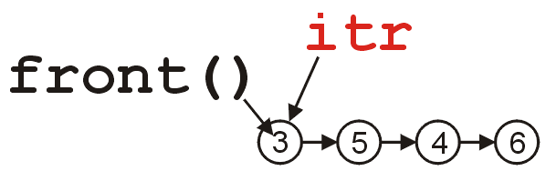
Iterators
3.4.5
We request an iterator on a specific instance of a deque by calling the member function begin():
deque<int> ideque;
ideque.push_front( 5 ); ideque.push_back( 4 );
ideque.push_front( 3 ); ideque.push_back( 6 );
// the deque is now 3 5 4 6
deque<int>::iterator itr = ideque.begin();

Slide 22
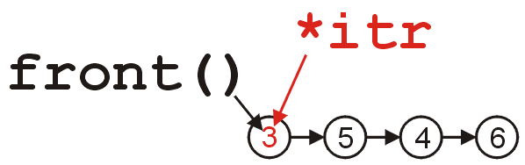

Iterators
3.4.5
We access the element by calling *itr:
cout << *itr << endl; // prints 3
Similarly, we can modify the element by assigning to *itr:
*itr = 11;
cout << *itr << " == " << ideque.front() << endl;
// prints 11 == 11

Slide 23
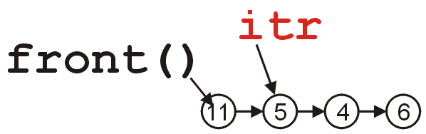
Iterators
3.4.5
We update the iterator to refer to the next element by calling ++itr:
++itr;
cout << *itr << endl; // prints 5

Slide 24
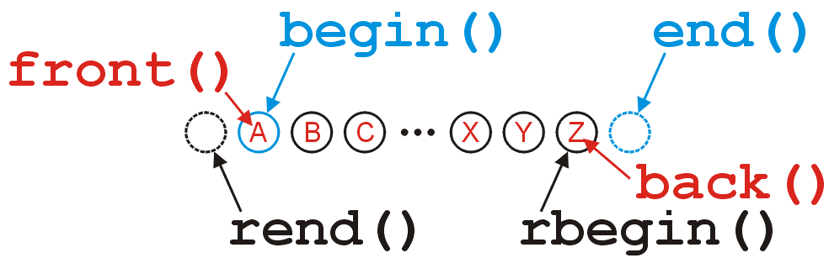
Iterators
3.4.5
The iterators returned by begin() and end() refer to:
The first position (head) in the deque, and
The position after the last element in the deque,
respectively:

Slide 25
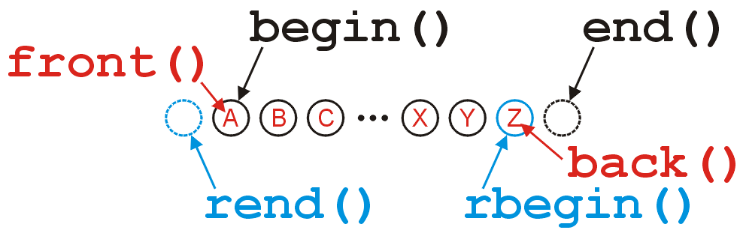
Iterators
3.4.5
The reverse iterators returned by rbegin() and rend() refer to:
the last position (tail) in the deque, and
the position before the first location in the deque,
respectively:

Slide 26
Iterators
3.4.5
If a deque is empty then the beginning and ending iterators are equal:
#include <iostream>
#include <deque>
using namespace std;
int main() {
deque<int> ideque;
cout << ( ideque.begin() == ideque.end() ) << " "
<< ( ideque.rbegin() == ideque.rend() ) << endl;
return 0;
}
{eceunix:1} ./a.out # output
1 1
{eceunix:2}

Slide 27
Iterators
3.4.5
Because we can have multiple iterators referring to elements within the same deque, it makes sense that we can use the comparison operator == and !=

Slide 28
Iterators
3.4.5
This code gives some suggestion as to why end() refers to the position after the last location in the deque:
for ( int i = 0; i != ideque.size(); ++i ) {
cout << ideque[i] << end;
}
for ( deque<int>::iterator itr = ideque.begin(); itr != ideque.end(); ++itr ) {
cout << *itr << end;
}

Slide 29
Iterators
3.4.5
Note: modifying something beyond the last location of the deque results in undefined behaviour
Do not use
deque<int>::iterator itr = ideque.end();
*itr = 3; // wrong
You should use the correct member functions:
ideque.push_back( 3 ); // right

Slide 30
Iterators
3.4.5
#include <iostream>
#include <deque>
using namespace std;
int main() {
deque<int> ideque;
ideque.push_front( 5 ); ideque.push_back( 4 );
ideque.push_front( 3 ); ideque.push_back( 6 ); // 3 5 4 6
deque<int>::iterator itr = ideque.begin();
cout << *itr << endl;
++itr;
cout << *itr << endl;
while ( itr != ideque.end() ) {
cout << *itr << " ";
++itr;
}
cout << endl;
return 0;
}
{eceunix:1} ./a.out # output
3
5
5 4 6
{eceunix:2}

Slide 31
Why Iterators?
3.4.5
Now that you understand what an iterator does, lets examine why this is standard software-engineering solution; they
Do not expose the underlying structure,
Require Θ(1) additional memory,
Provide a common interface which can be used regardless of whether or not it’s a vector, a deque, or any other data structure
Do not change, even if the underlying implementation does

Slide 32
Summary
In this topic, we have introduced the more general deque abstract data structure
Allows insertions and deletions from both ends of the deque
Internally may be represented by either a doubly-linked list or a two-ended array
More important, we looked at the STL and the design pattern of an iterator

Slide 33
References
[1] Donald E. Knuth, The Art of Computer Programming, Volume 1: Fundamental Algorithms, 3rd Ed., Addison Wesley, 1997, §2.2.1, p.238.
[2] Weiss, Data Structures and Algorithm Analysis in C++, 3rd Ed., Addison Wesley, §3.3.1, p.75.

Slide 34
References
Donald E. Knuth, The Art of Computer Programming, Volume 1: Fundamental Algorithms, 3rd Ed., Addison Wesley, 1997, §2.2.1, p.238.
Cormen, Leiserson, and Rivest, Introduction to Algorithms, McGraw Hill, 1990, §11.1, p.200.
Weiss, Data Structures and Algorithm Analysis in C++, 3rd Ed., Addison Wesley, §3.3.1, p.75.
Koffman and Wolfgang, “Objects, Abstraction, Data Strucutes and Design using C++”, John Wiley & Sons, Inc., Ch. 6.
Wikipedia, http://en.wikipedia.org/wiki/Double-ended_queue
These slides are provided for the ECE 250 Algorithms and Data Structures course. The material in it reflects Douglas W. Harder’s best judgment in light of the information available to him at the time of preparation. Any reliance on these course slides by any party for any other purpose are the responsibility of such parties. Douglas W. Harder accepts no responsibility for damages, if any, suffered by any party as a result of decisions made or actions based on these course slides for any other purpose than that for which it was intended.

